Slide 1

Smart Employee
“Where employee’s work smartly”
KHUSHALI PATEL - 176440307048
Under the supervision of Prof. BHASKAR PATEL

Slide 2

We are grateful to our project guide Prof. BHASKAR PATEL for the guidance, inspiration and constructive suggestions that helps me in the preparation of this project.

Slide 3

Content Of Presentation
Introduction
Existing system
Need for the
new system
Proposed System
System Flow
Diagram
UML Diagrams

Slide 4
What is EMS?
Employee management system.
Records maintenance of employee in an organization.
Manages the information of employees.
Improves the HR process and simple day-to-day activities.
This is beneficial for an organization as well as the employee.
Employees can access the system to apply for leaves, view their attendance, login and logout time, etc.

Slide 5
EXISTING SYSTEM
The records are maintained manually.
Existing system is based on standalone system.
The HR Administration falls short for controlling the employee’s activities.
The existing system has time consuming processes.
Complicated searching, editing & updating.
Existing system is not very User-Friendly.

Slide 6
Problem area of existing system
Need of extra manual effort.
As current system is standalone normal employees cannot track their employment status.
It used to take much time to find any employee.
Not very much accurate.
Danger of losing the files in some cases.
Certain required report is not available .

Slide 7


Need of new system
Need 01
Need 02
To avoid the paper work
Very fast and accurate.
Need 03
Need 04
Time Management
Communication
Need 05
Need 06
Easy Management
No extra hardware device

Slide 8
PURPOSE OF SYSTEM
Easy to find the various information related to employee.
Maintain the salary, attendance, events, leave and request.
We will add some special features which will allow user to communicate and maintain good relationships with the team.
This system efficiently add or retrieve data from database.

Slide 9
Modules
Admin
Human resources(HR)
Project manager
Employee

Slide 10
Admin
The admin module is the central controller of the system or owner of the company.
The admin can see any information of employees who are working in its company and also manipulate information at some level.
Admin has access to all the reports, personal details and documents related to the project.

Slide 11



SMART EMPLOYEE-ADMIN
FINAL
REPORT
PROJECT
DETAILS
VIEW
EMPLOYEE

Slide 12
Human resource
A Human Resource is a form that combines a number of systems and processes to ensure the easy management of processes and data.
HR manages the leave applications of the employee.
It manages the entry and the exit of the employee in this system.
HR can also manage the reports of the employee according to their performance.
HR receives the order request which is done by the employee and HR try to fulfill that request.

Slide 13





SMART EMPLOYEE-HUMAN RESOURCES
ATTENDENCE
MANAGE
LEAVE
EMPLOYEE
DETAILS
REPORT

Slide 14
Project manager
Project manager is a person in an organization which handles the particular project.
Project manager assign the employees according to the needs of the projects.
Project manager also assign the different task to their team.
Project manager also provides the reports of the team to the HR .

Slide 15





SMART EMPLOYEE-PROJECT MANAGER
PROJECT
EMPLOYEE
ASSIGNING
TASK
REPORT

Slide 16
EMPLOYEE
Employee is most important module of are system.
Employee can generate his salary pay slip.
Employee can do shopping from office according to his monthly credits.
Employee also send the leave requests to the HR directly through this system.
Employee can also see the public holidays which provided by the organization.
employee get notified when any new tasks allotted to him/her.
He/she can also edit the task status in the system it also see their pending tasks.

Slide 17






SMART EMPLOYEE-EMPLOYEES
Attendance
Task
Holidays
Leave
Request
Shopping
Salary

Slide 18


Slide 19
Start
If registered?
Registration
No
Yes
Login
HR
PROJECT MANAGER
EMPLOYEE
ADMIN
A
B
C
D

Slide 20
A
HR
B
ADMIN
C
PROJECT
MANAGER
D
EMPLOYEE
View Profile
Edit Profile
Manage Project
View Assigned Project
Manage Employee
Employee detail
View Project Status
View Assigned Task
Manage Category
View report
View Report
Assign Employee According To
Project Skill
Complete His/her Task
Manage Order
View project Status
Ask Query To Project Manager
Give Task To Employee
View Report
View Project
Give Project Status
View Project Report
Manage Message
Send Project Screen
Answer Employee’s Query
Manage
manage
Manage Message
Message
Manage Message
Logout
Stop

Slide 21
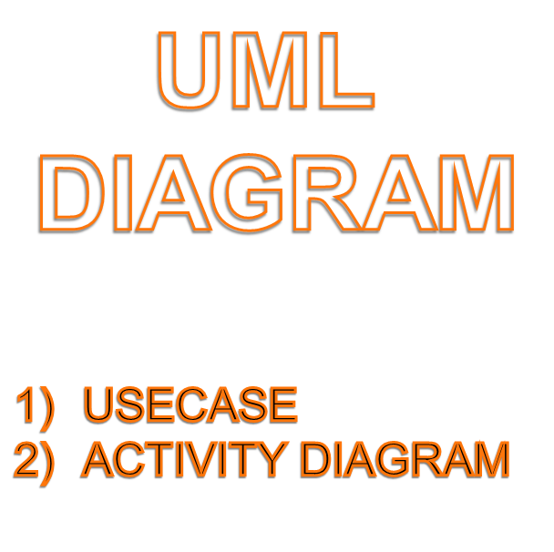

Slide 22


Slide 23
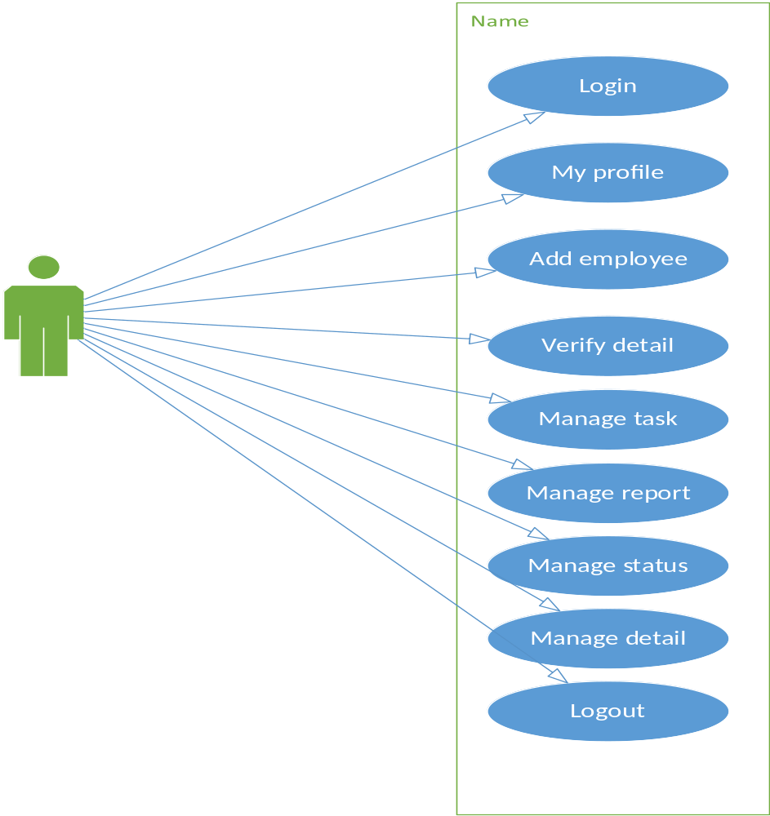
ADMIN

Slide 24
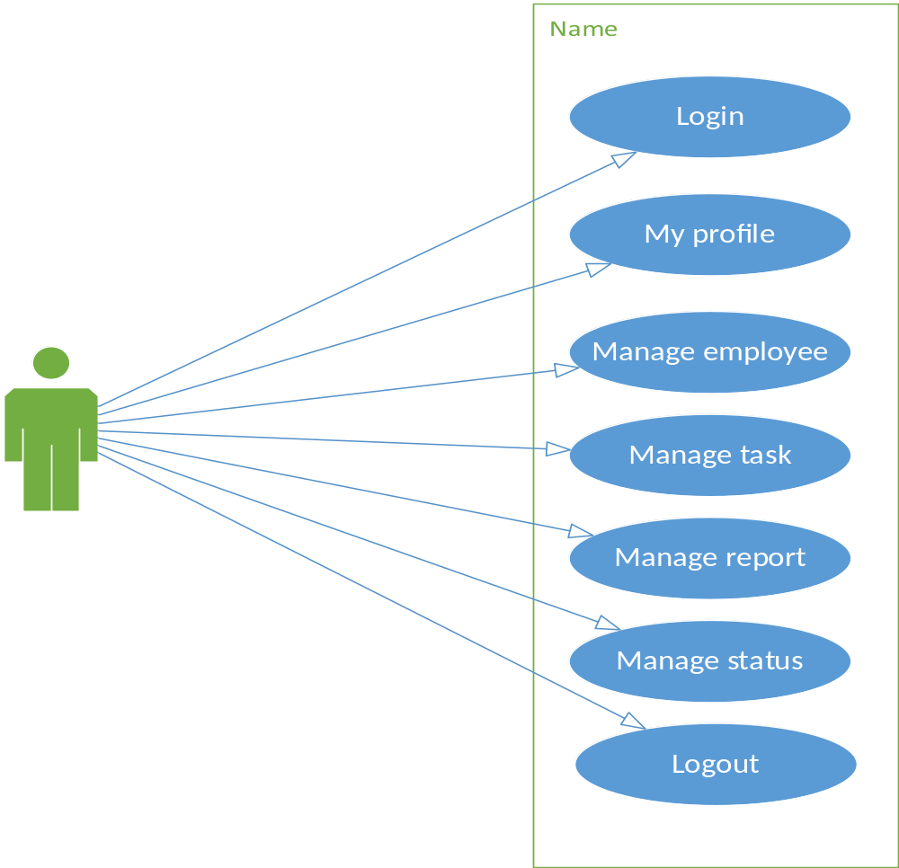
HR

Slide 25
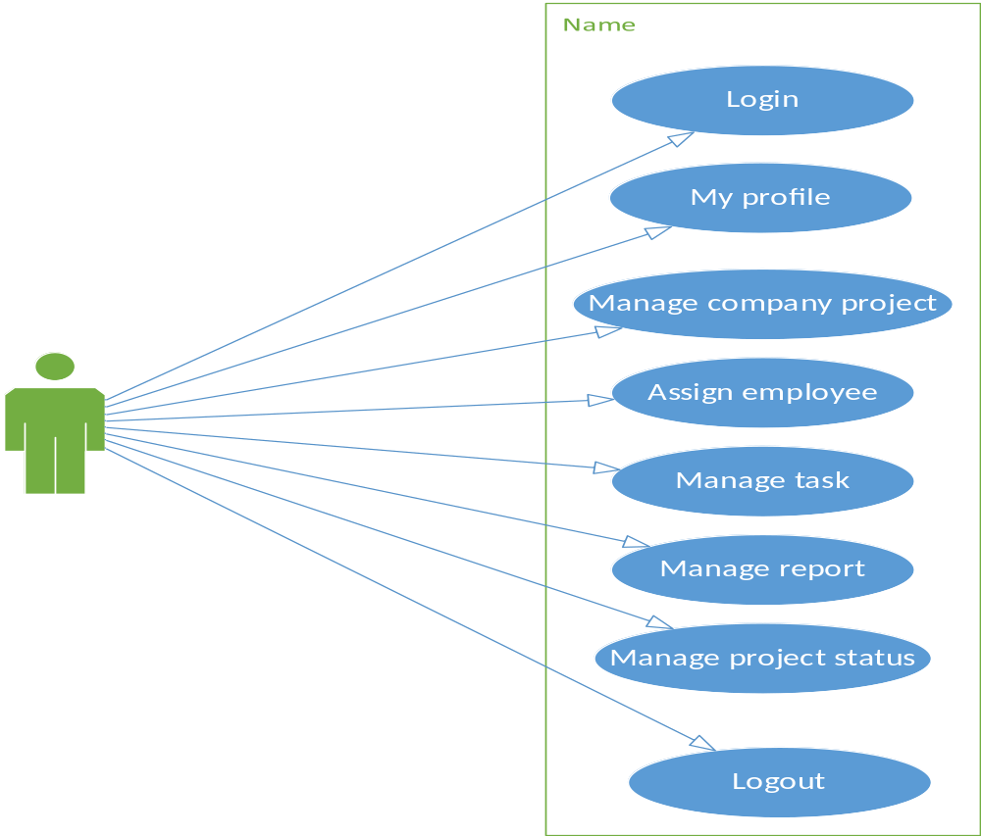
PROJECT
MANAGER

Slide 26
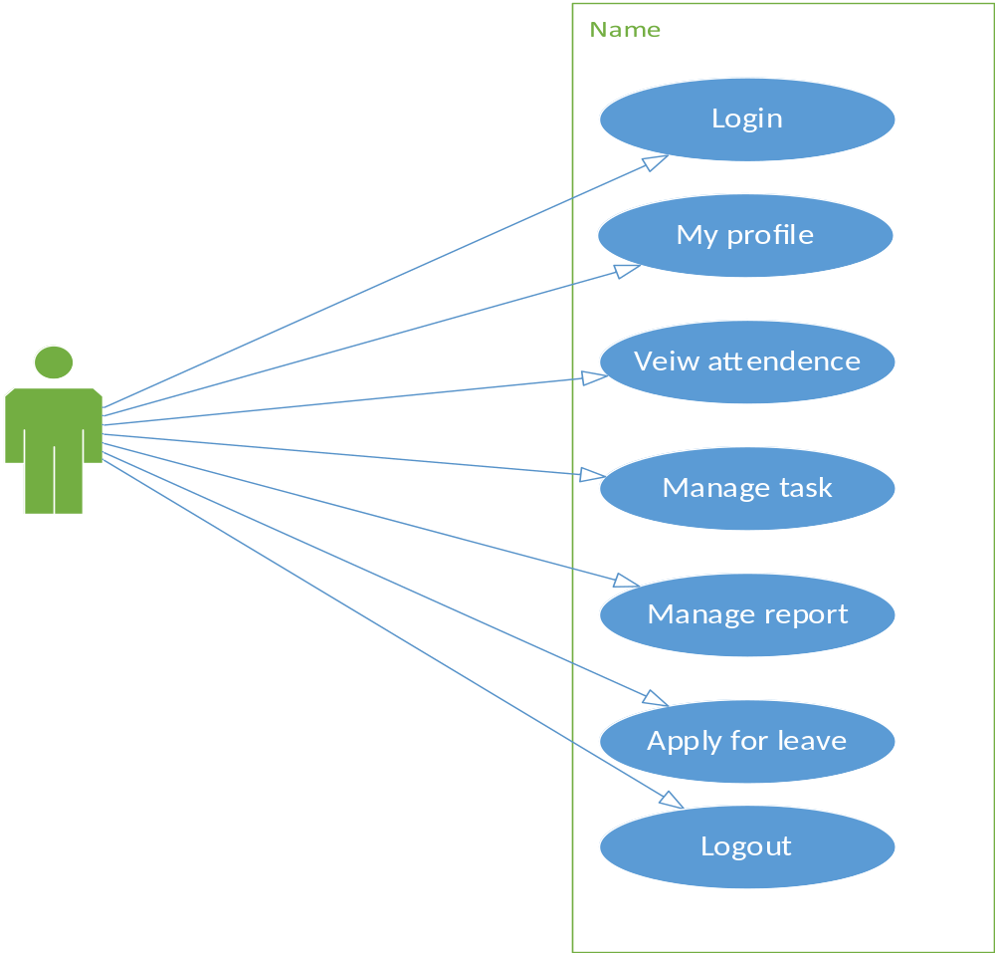
EMPLOYEE

Slide 27


Slide 28
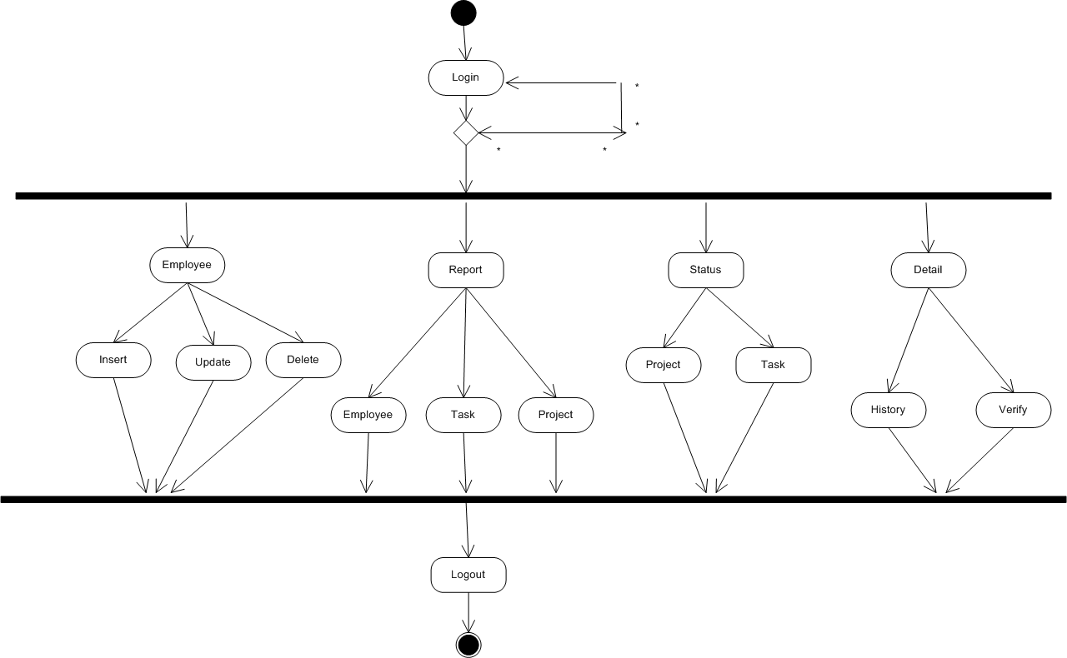


ADMIN

Slide 29
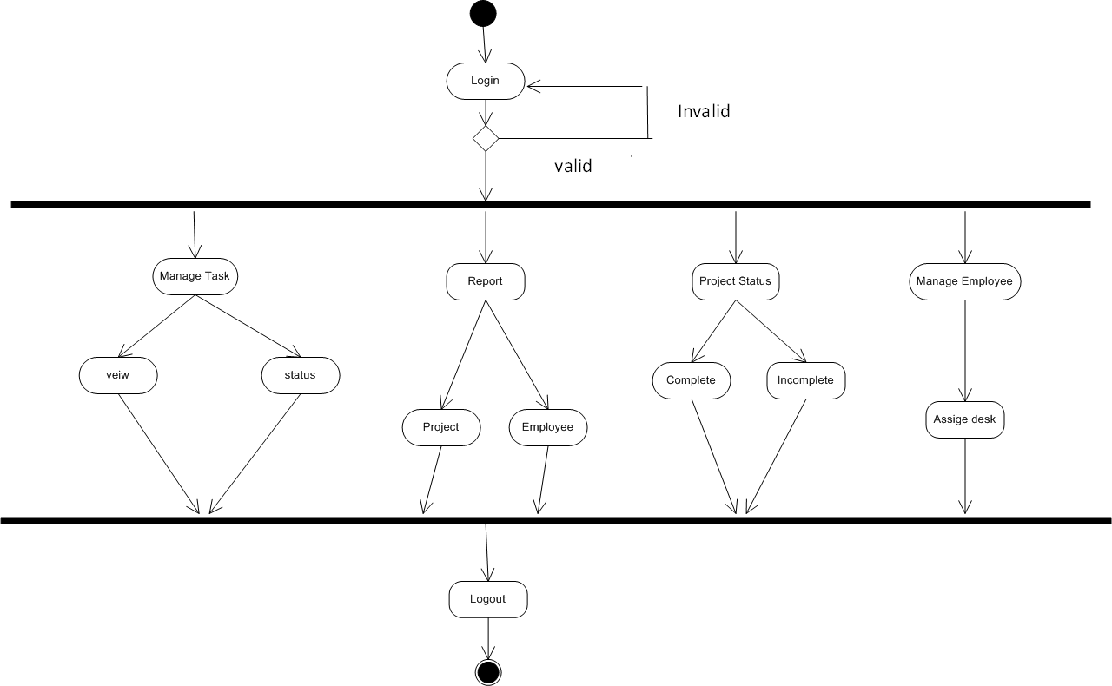
HR

Slide 30
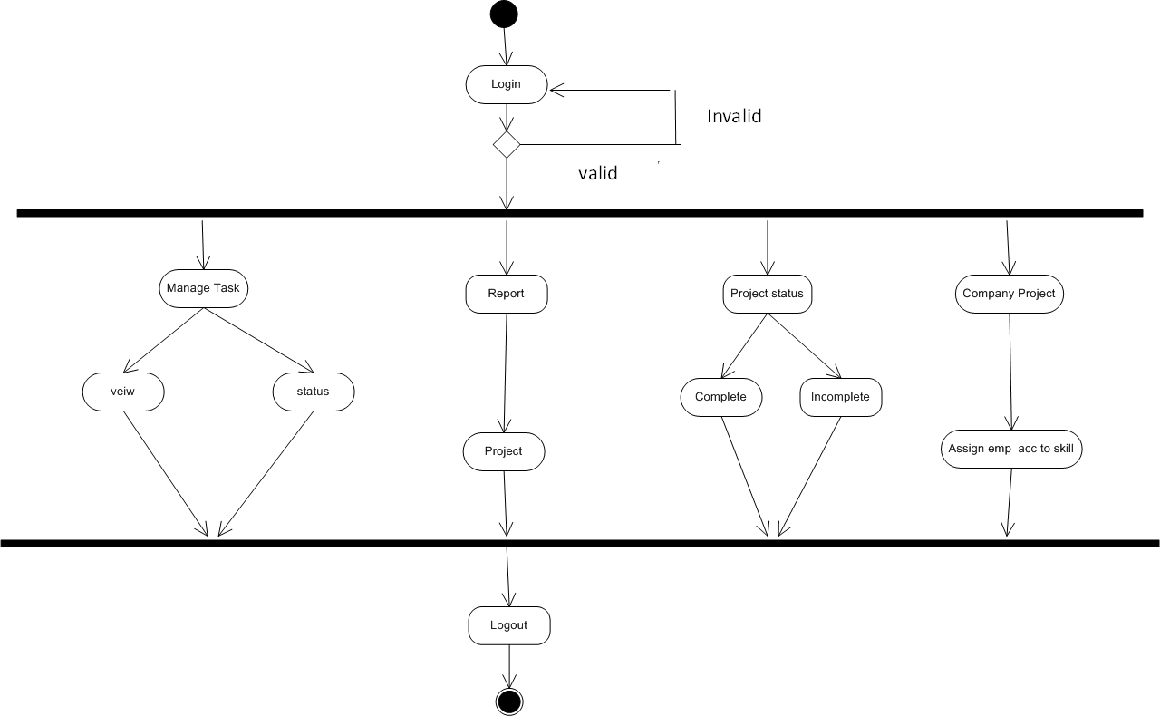
PROJECT MANAGER

Slide 31
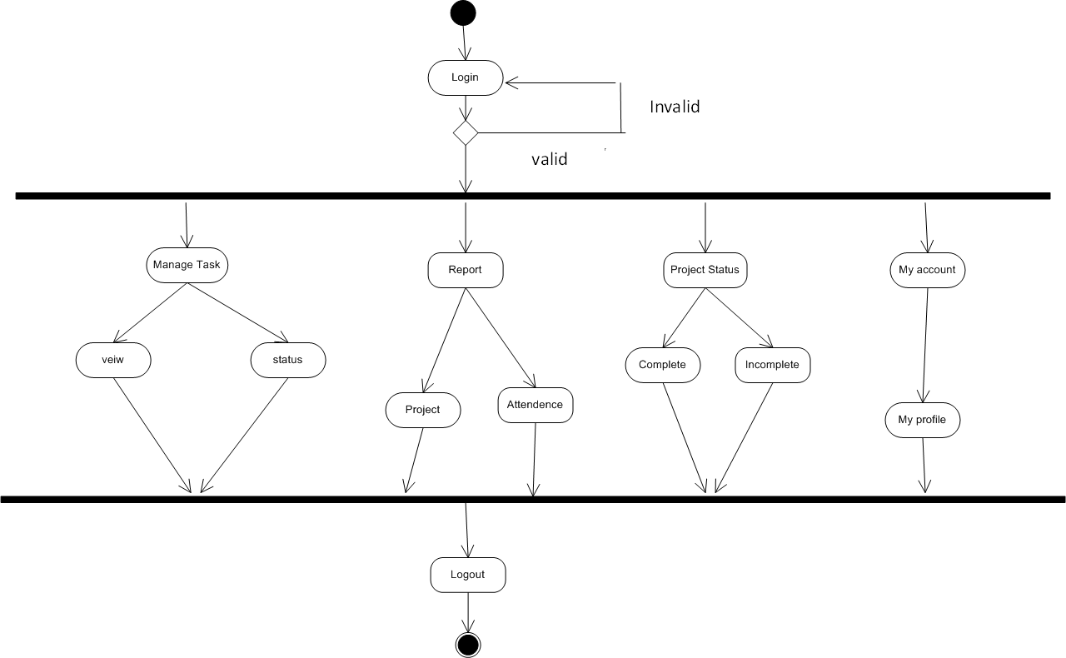
EMPLOYEE

Slide 32
Data dictionary
Employee Role
Employee Project
Technology
Employee
Project Technology
Employee Technology
Project Employee
Task
Task file

Slide 33
1) Employee Role
FIELD_NAME | DATA TYPE | SIZE | CONSTRAINTS | DESCRIPTION
Roleid | Int | 30 | Primary key | Employee Role id
Rolename | Varchar | 30 | - | Role name
Allowance | Int | 6 | - | Allowance

Slide 34
2) Employee Project
FIELD_NAME | DATE TYPE | SIZE | CONSTRAINTS | DESCRIPTION
Pid | Int | 30 | Primary key | Project id
Ptitle | Varchar | 50 | - | Project title
Plogo | Varchar | 50 | - | Project logo
Client | Varchar | 50 | - | Client
Dos | Date | - | - | Date of start
Doe | Date | - | - | Date of end
Project description | Varchar | 250 | - | Project description

Slide 35
3) Technology
FIELD_NAME | DATA TYPE | SIZE | CONSTRAINTS | DESCRIPTION
Technoid | Int | 30 | Primary key | Technology id
Technoname | Varchar | 50 | - | Technology name
Technopic | Varchar | 40 | - | Technology pic

Slide 36
4) Employee
FIELD_NAME | DATATYPE | SIZE | CONSTRAINTS | DESCRIPTION
Empid | Int | 30 | Primary key | Employee identification code.
Uname | Varchar | 30 | - | Employee name
Password | Varchar | 30 | - | Employee password
Contactno | Int | 30 | - | Employee contact no
Email | Varchar | 40 | - | Employee email id
DOB | Date | - | - | Employee birth date
RoleId | Int | 30 | Foreign key | Employee role in company

Slide 37
5) Project Technology
FIELD_NAME | DATA TYPE | SIZE | CONSTRAINTS | DESCRIPTION
Ptid | Int | 30 | Primary key | Project technology id
Technoid | Int | 30 | Foreign key | Technology id
Pid | Int | 30 | Foreign key | Project id

Slide 38
6) Employee Technology
FIELD_NAME | DATA TYPE | SIZE | CONSTRAINTS | DESCRIPTION
Emtid | Int | 30 | Primary key | Employee technology id
Empid | Int | 30 | Foreign key | Employee id
Technoid | Int | 30 | Foreign key | Technology id

Slide 39
7) Project Employee
FIElD_NAME | DATA TYPE | SIZE | CONSTRAINTS | DESCRIPTION
Peid | Int | 30 | Primary key | Project employee id
Pid | Int | 30 | Foreign key | Project id
Etid | Int | 30 | Foreign key | Employee tag id
Dos | Date | - | - | Date of start
Doe | Date | - | - | Date of end

Slide 40
8) Task
FIELD_NAME | DATA TYPE | SIZE | CONSTRAINTS | DESCRIPTION
Taskid | Int |  | Primary key | Task id
Task_name | Varchar | 30 | - | Task name
Peid | Int |  | Foreign key | Project Employee id
Dos | Date | - | - | Date of start
Doe | Date | - | - | Date of end

Slide 41
9) Task file
FIELD_NAME | DATA TYPE | SIZE | CONSTRAINTS | DESCRIPTION
Tfid | Int | 30 | Primary key | Task file id
Taskid | Int | 30 | Foreign key | Task id
Tfilepath | Varchar | 50 | - | Task file path

Slide 42


